Slide 1
Artificial Neural Network

Slide 2
Perceptron 이란
입력데이터에서 output을 예측
뉴런에서 착안
Input node
w1
link
w2
output node
w3
weight

Slide 3
Perceptron 작동
x1
w1
w2
x2
y
y = f(sum(xi*wi)+b)
w3
x3

Slide 4

Perceptron learning
$w_{j}^{(k+1)}=w_{j}^{(k)}+λ(y_{i}−{\hat{y}}_{i}^{(k)})x_{ij}$

Slide 5
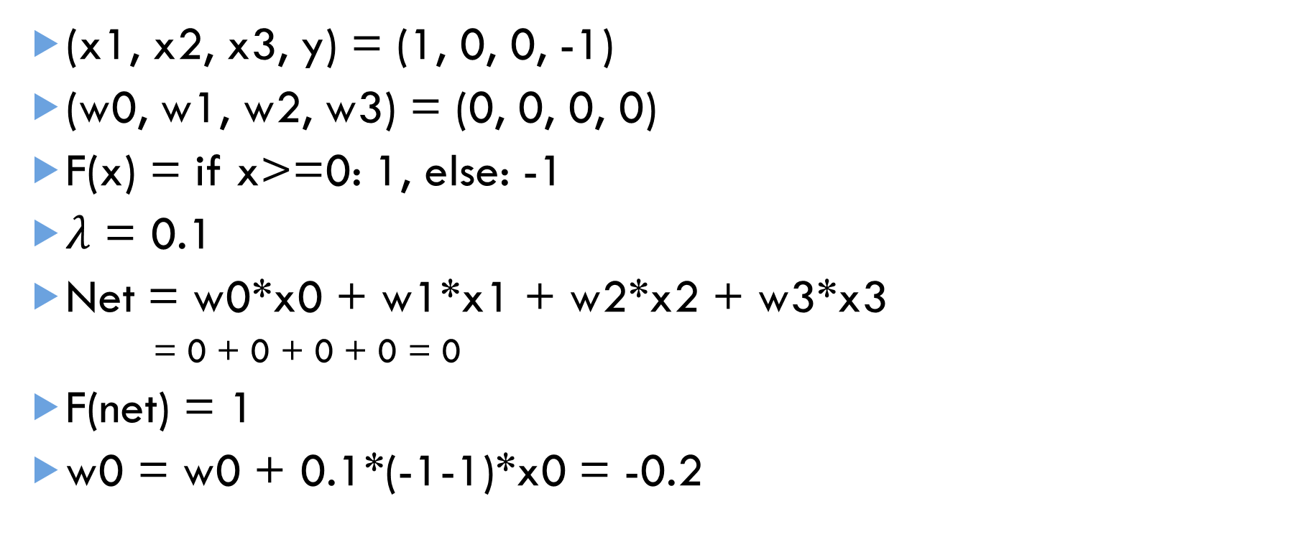
Perceptron learning example
(x1, x2, x3, y) = (1, 0, 0, -1)
(w0, w1, w2, w3) = (0, 0, 0, 0)
F(x) = if x>=0: 1, else: -1
$λ$ = 0.1
Net = w0*x0 + w1*x1 + w2*x2 + w3*x3
= 0 + 0 + 0 + 0 = 0
F(net) = 1
w0 = w0 + 0.1*(-1-1)*x0 = -0.2

Slide 6
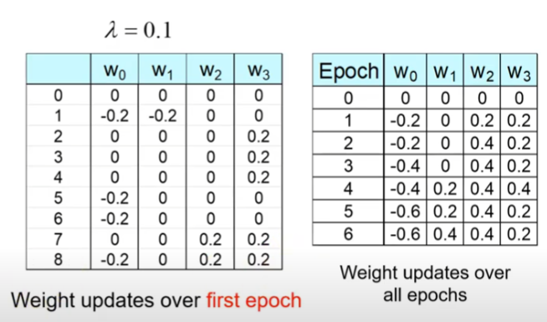
Step, Epoch
step

Slide 7
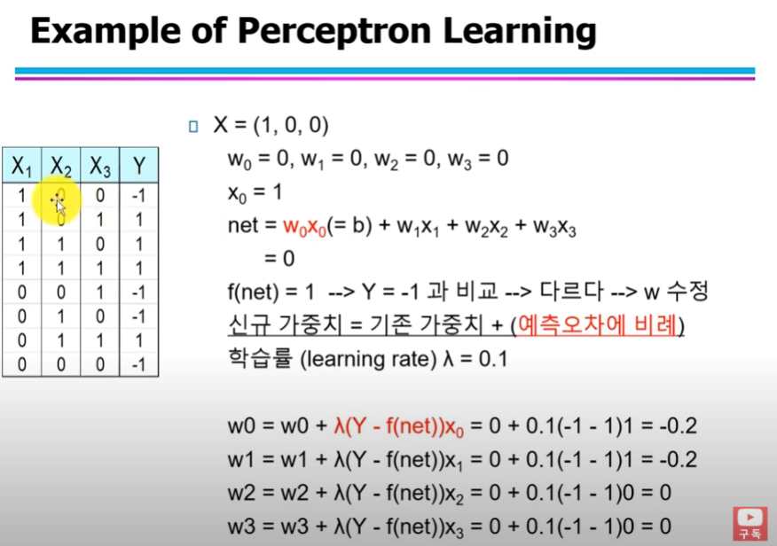
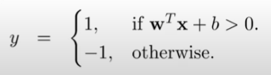
Perceptron Coding
>=

Slide 8
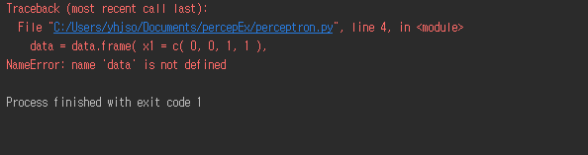
Perceptron Coding

Slide 9
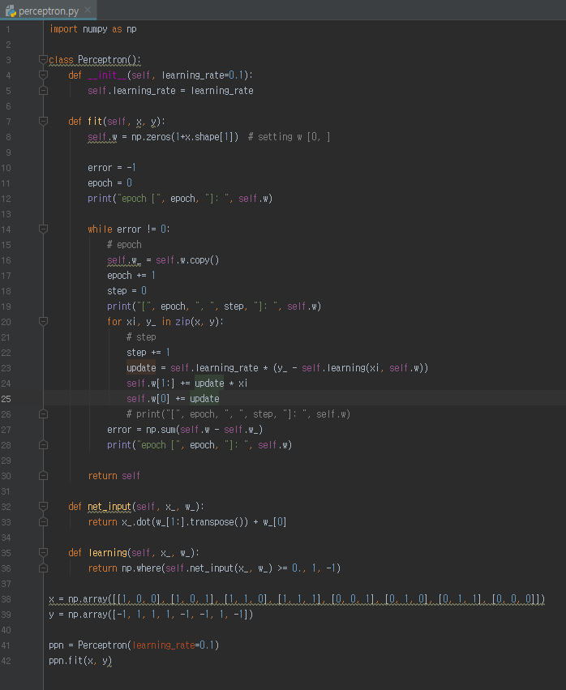

Perceptron Coding - Code

Slide 10
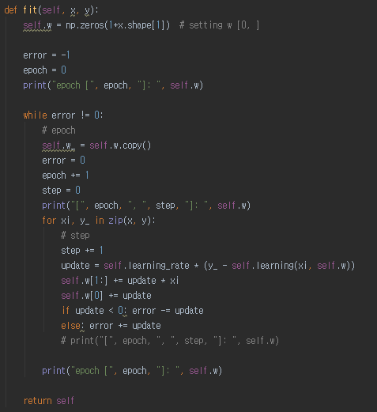
Perceptron Coding - Code
Step, epoch:
for numbering
w, w_:
weight and last weight
Error :
stopping condition
Update:
y-y’

Slide 11
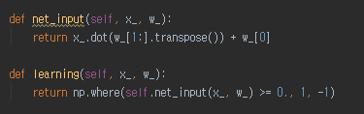
Perceptron Coding - Code

Slide 12
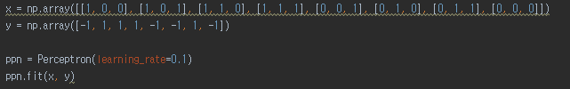
Perceptron Coding - Code

Slide 13
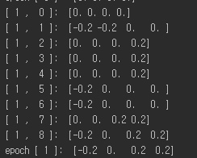
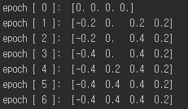
Perceptron Coding - Result

Slide 14
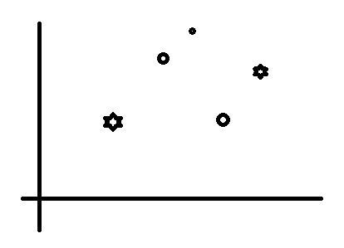
Perceptron 단점
Nonlinear problem은 처리할 수 없다.
→ Multi-layer neural network

Slide 15
Multi-layer neural network
Input layer
Hidden layer
Output layer

Slide 16
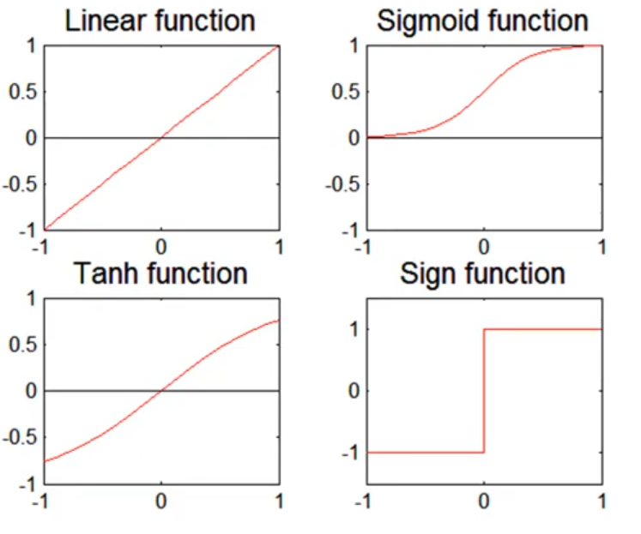
Activation Function
A = f(z)

Slide 17

Learning
Loss function
Gradient descent
$w_{ij}^{l}←w_{ij}^{l}−λ\frac{dE}{dw_{ij}^{l}}$
Backpropagation
Notes:
가중치 조절 → Gradient descent, adam, 모멘텀 등등 (특히 gradient descent 조사)

Slide 18
DNN’s Problem and Overcome
Vanishing gradient problem (기울기 소실 문제)
ReLU, Adam…
Sensitive to the initial values of model parameters
Pretraining
High model complexity
Dropout

